Slide 1
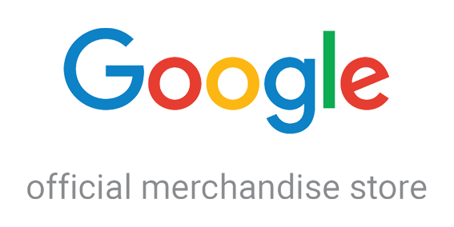
INSY-5377-002
Web & Social Analytics
Summer 2022
KAMARGA, CHRISTIAN
SHUKLA, RUCHI
VAN KEER, BART

Slide 2
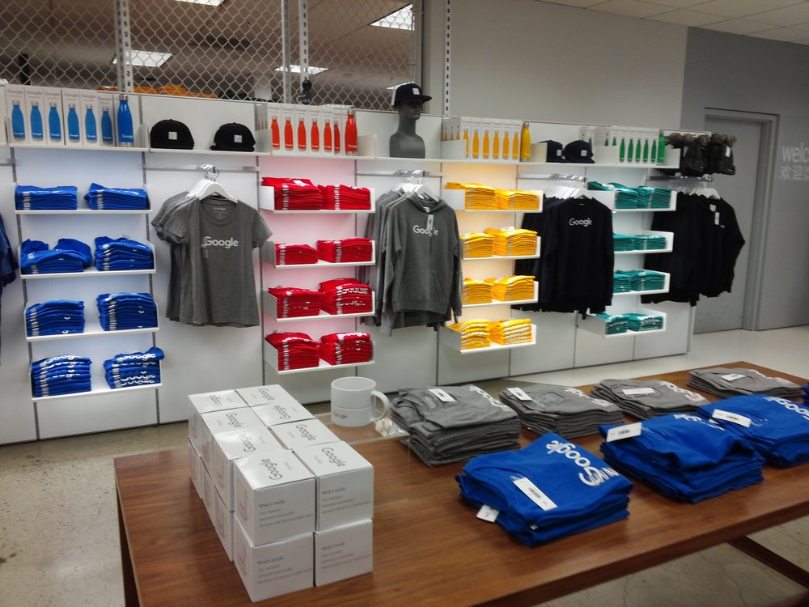
Introduction
Businesses need analytics tools and data to reveal insight that can be used towards optimizing their online site and understanding their customers.
In this presentation, we will observe the web analytics data of a Google Merchandise Store (called GStore) that sells Google themed merchandise and paraphernalia. The store’s online site attracts visitors from various locations throughout the world.
https://shop.googlemerchandisestore.com/

Slide 3
Data Description & Source
GStore’s customer dataset was downloaded from Kaggle:
https://www.kaggle.com/competitions/ga-customer-revenue-prediction/data?select=train.csv
In context, Kaggle and Google Cloud partnered with RStudio, a developer of many free and open source tools for business analytics. Together, they hosted an official competition with this dataset to predict revenue per customer.
There were roughly a million records (or rows) in the Spreadsheet. The visits range from Q3 2016 through Q2 2017.

Slide 4
Variables
channelGrouping - The referent channel or source that explains how the user visited the Store.
date - The date on which the user visited the Store.
device - The specifications for the device used to access the Store.
fullVisitorId- A unique identifier for each user of the Google Merchandise Store.
geoNetwork - This section contains information about the geography of the user.
hits - This row and nested fields are populated for any and all types of hits. Provides a record of all page visits.
socialEngagementType - Engagement type, either "Socially Engaged" or "Not Socially Engaged".
totals - This set of columns mostly includes high-level aggregate data.
trafficSource - This section contains information about the Traffic Source from which the session originated.
visitId - An identifier for this session. This is part of the value usually stored as the _utmb cookie. This is only unique to the user. For a completely unique ID, you should use a combination of fullVisitorId and visitId.
visitNumber - The session number for this user. If this is the first session, then this is set to 1.
visitStartTime - The timestamp (expressed as POSIX time).

Slide 5
Research Questions
Descriptive Analysis:
Which independent variables influence the dependent variables the most?
From where (geographic) are visitors coming? Based on website behaviors, are certain places more important to us than others?
What devices, browser, and operating system do visitors prefer?
What are the number of total hits, pageviews, and conversion rate?
What is the likelihood a visitor will see our website just once? What percentage of visitors return?
Does one traffic source category dominate disproportionally?
What is the trend for organic search traffic?
What is the aggregated revenue generated from each user based on our independent variables?
Predictive Analysis:
Which features most contributed to the conversion of visitors? Assuming circumstances in the future are similar, which features would most benefit GStore to focus on? How can GStore use this information to improve?

Slide 6
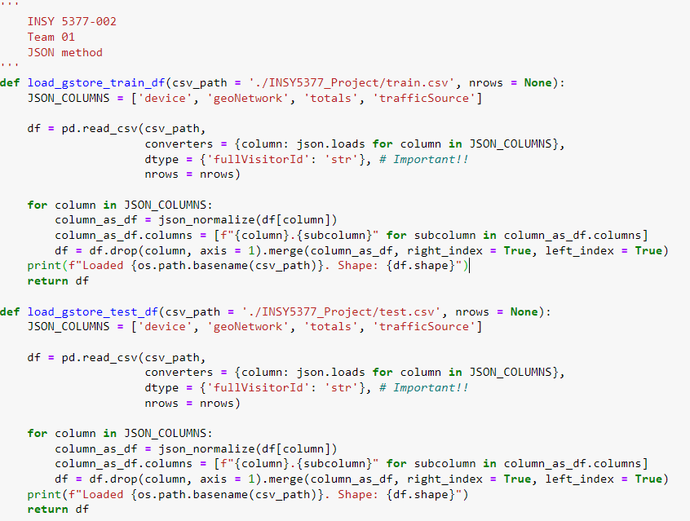
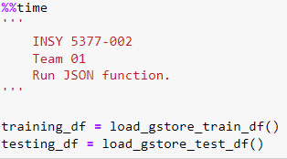
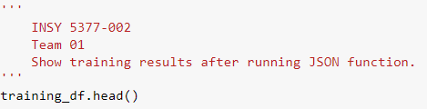
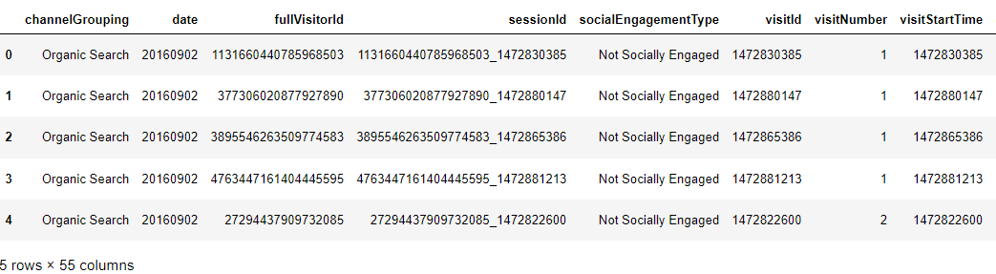
Methodology: Preprocessing/Cleaning
We used Jupyter Notebook for preprocessing/cleaning our dataset.
Initially, we had 12 variables. After applying JSON on 4 of the 12 variables, we obtained a total of 55 columns.

Slide 7
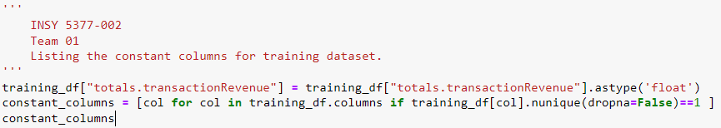
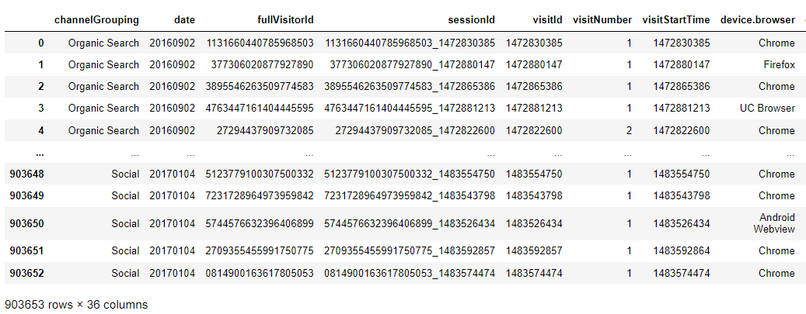
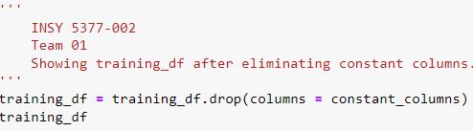
Methodology: Preprocessing/Cleaning (Cont.)
However, some of these columns did not contribute meaningful information to the analysis (e.g. Null (NaN) values, constants, etc.) and we decided to drop them. As a result, out of the initial 55 columns, we only considered 36 columns for our analysis.

Slide 8
Independent/Dependent Variables
Resulting 35 independent variables are:
channelGrouping, date, fullVisitorId, sessionId, visitId, visitNumber, visitStartTime, device.browser, device.operatingSystem, device.isMobile, device.deviceCategory, geoNetwork.continent, geoNetwork.subContinent, geoNetwork.country, geoNetwork.region, geoNetwork.metro, geoNetwork.city, geoNetwork.networkDomain, totals.hits, totals.pageviews, totals.bounces, totals.newVisits, trafficSource.campaign, trafficSource.source, trafficSource.medium, trafficSource.keyword, trafficSource.isTrueDirect, trafficSource.referralPath, trafficSource.adwordsClickInfo.page, trafficSource.adwordsClickInfo.slot, trafficSource.adwordsClickInfo.gclId, trafficSource.adwordsClickInfo.adNetworkType, trafficSource.adwordsClickInfo.isVideoAd, trafficSource.adContent, trafficSource.campaignCode
Our dependent variable is total.transactionRevenue.

Slide 9
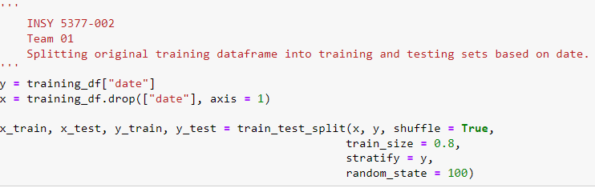
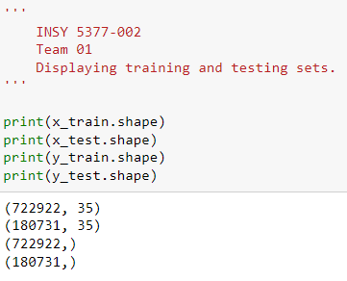
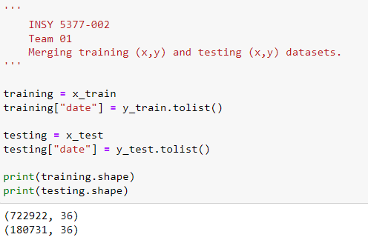
Methodology: Splitting Dataset into Train & Test
Dataset was split utilizing the date column (80-20 split)
After splitting, the x and y components of training and testing split were recombined to form final training and testing datasets.

Slide 10
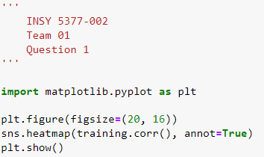
Results & Discussion: Question 1
Which independent variables influence the dependent variables the most?
The following code produces a HeatMap that displays the correlation between the dependent and independent variables. The lighter colors indicate a strong relationship between the corresponding pairs of variables. See next slide for heatmap.

Slide 11
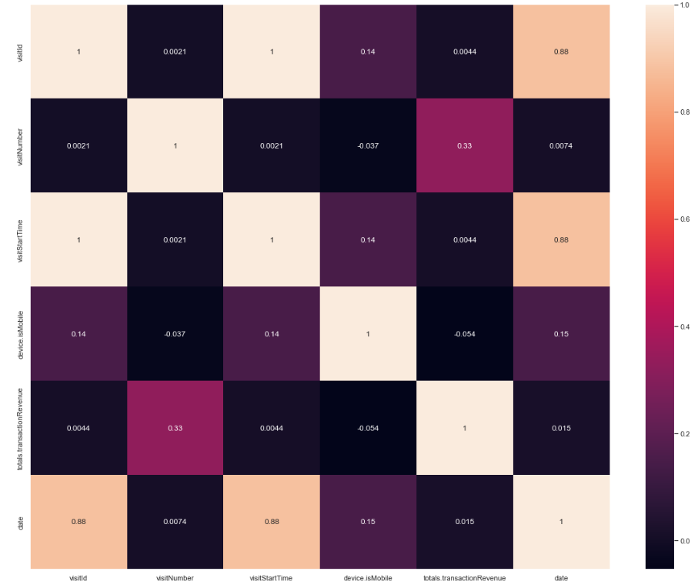
Results & Discussion: Question 1 (Cont.)
The heatmap show a strong correlation between date and visitStartTime & visitId (0.88).
In addition, it shows a correlation between visitNumber and totals.transactionRevenue (0.33).

Slide 12
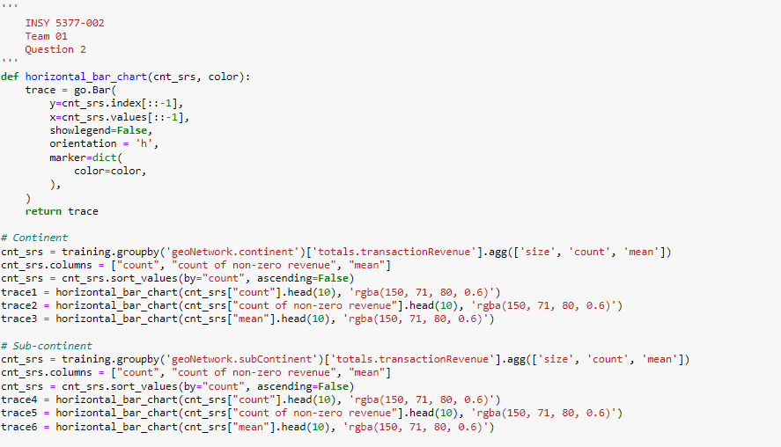
Results & Discussion: Question 2
From where (geographic) are visitors coming? Based on website behaviors, are certain places more important to us than others?

Slide 13
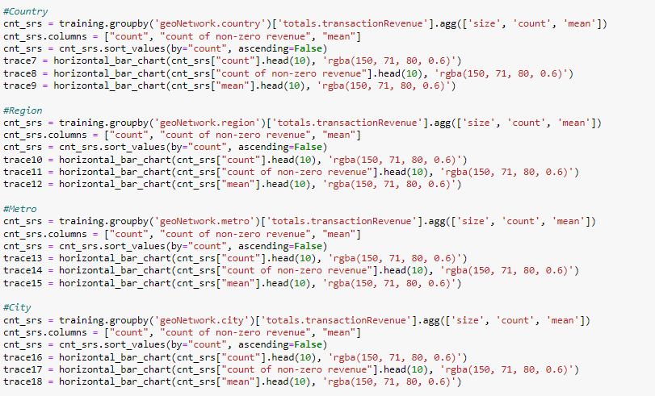
Results & Discussion: Question 2 (Cont.)

Slide 14
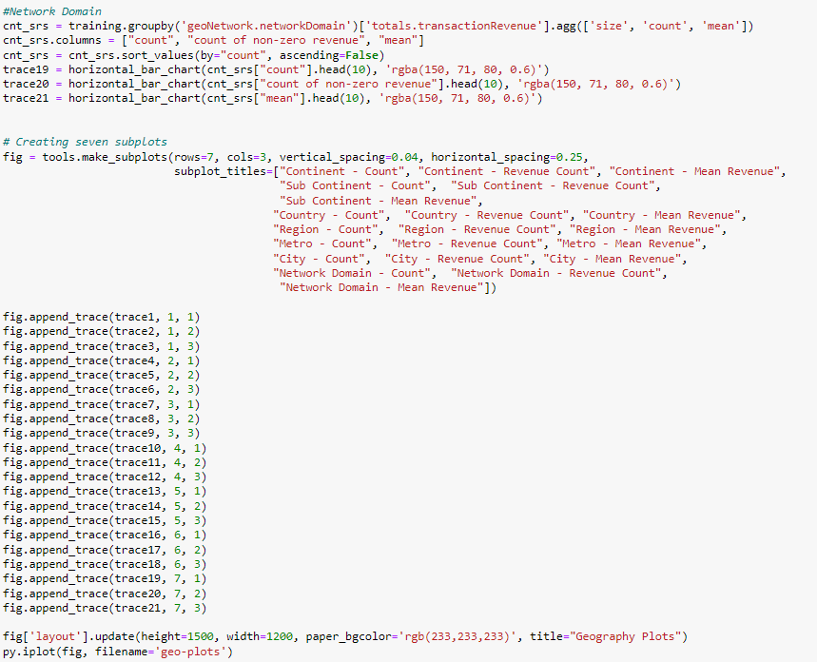
Results & Discussion: Question 2 (Cont.)

Slide 15
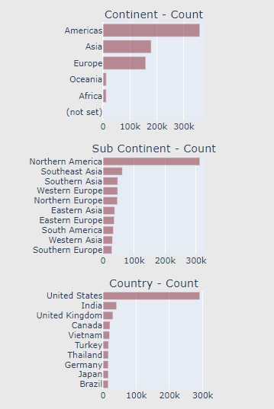
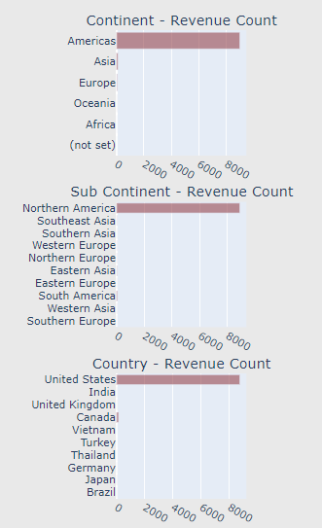
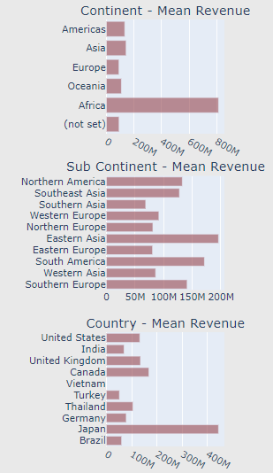
Results & Discussion: Question 2 (Cont.)
Total Visitors = 722,922k; Total Conversions = 9,178
360,107k, 49.8%
8,993, 98.0%
179,124k, 24.8%
158,684k, 22.0%
312,476k, 43.2%
8,889, 96.9%
291,728k, 40.4%
8,738, 95.2%

Slide 16
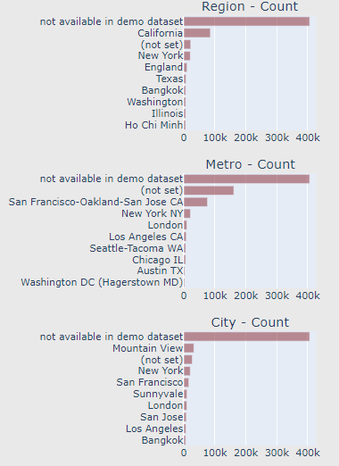
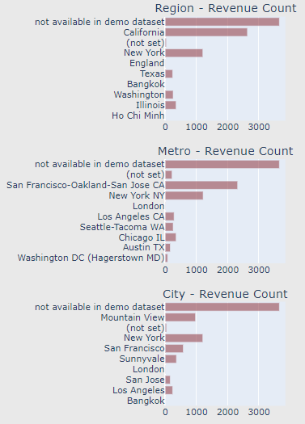
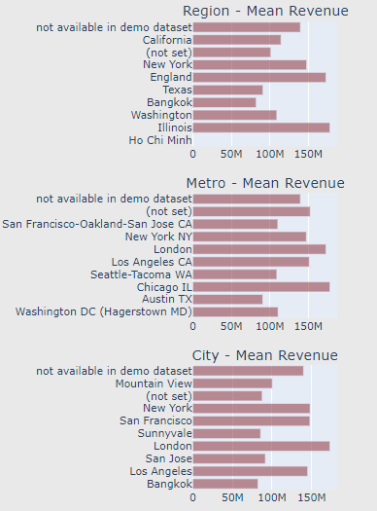
Results & Discussion: Question 2 (Cont.)
Total Visitors = 722,922k; Total Conversions = 9,178
85,952k, 11.9%
2,635, 28.7%
21,037k, 2.9%
1,205, 13.1%
76,685k, 10.6%
2,320, 25.3%
32,664k, 4.5%
1,204, 13.1%

Slide 17
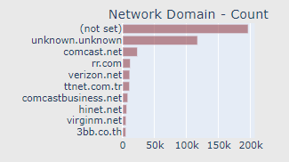
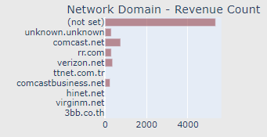
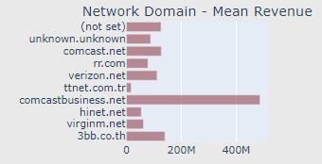
Results & Discussion: Question 2 (Cont.)
Total Visitors = 722,922k; Total Conversions = 9,178
22,927k, 3.2%
747, 8.1%

Slide 18
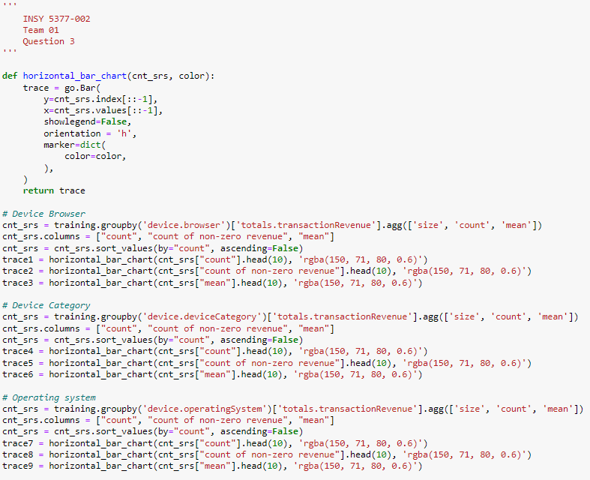
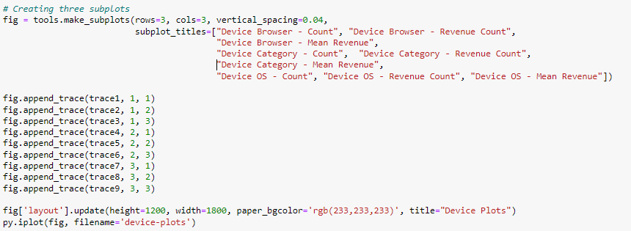
Results & Discussion: Question 3
What devices, browser, and operating system do visitors prefer?

Slide 19
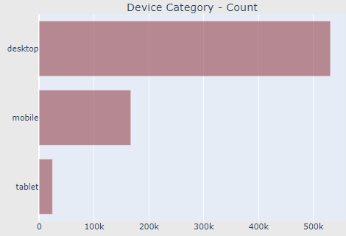
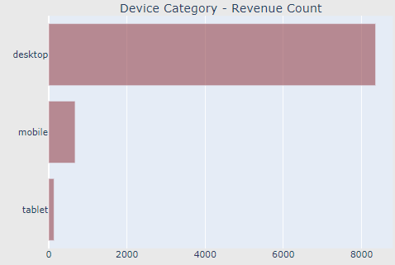
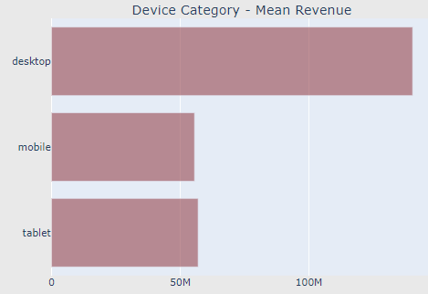
Results & Discussion: Question 3 (Cont.)
Device visitors prefer accessing the GStore using a Desktop - 73.5%, followed by Mobile - 23.1%

Slide 20
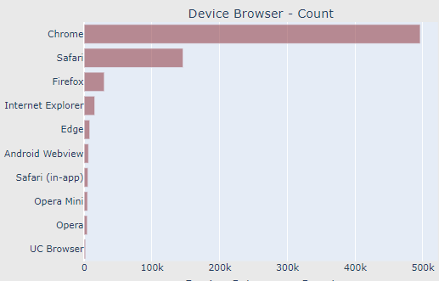
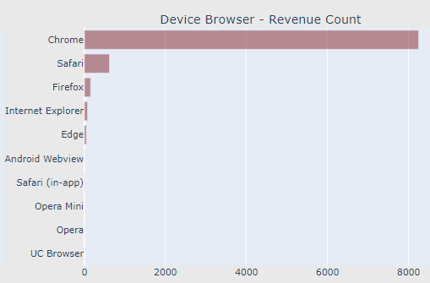
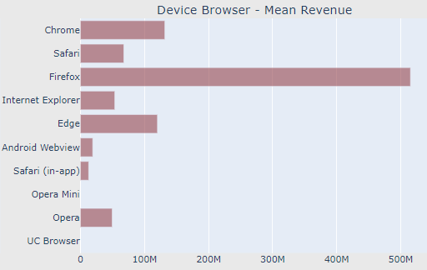
Results & Discussion: Question 3 (Cont.)
Preferred Browser is Chrome - 68.6%, followed by Safari - 20.2%

Slide 21
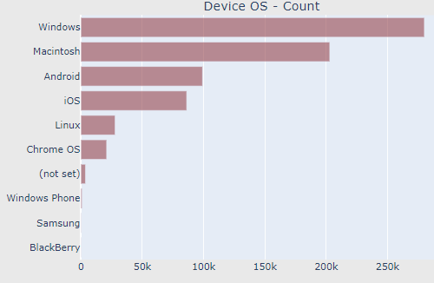
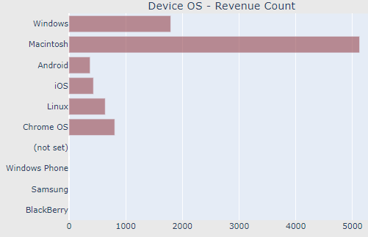
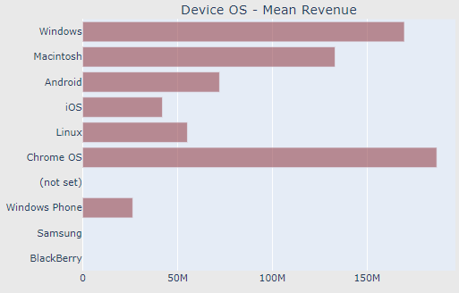
Results & Discussion: Question 3 (Cont.)
Preferred Operating System is Windows - 38.8%, followed by Mac - 28.1% and Android - 13.7%

Slide 22
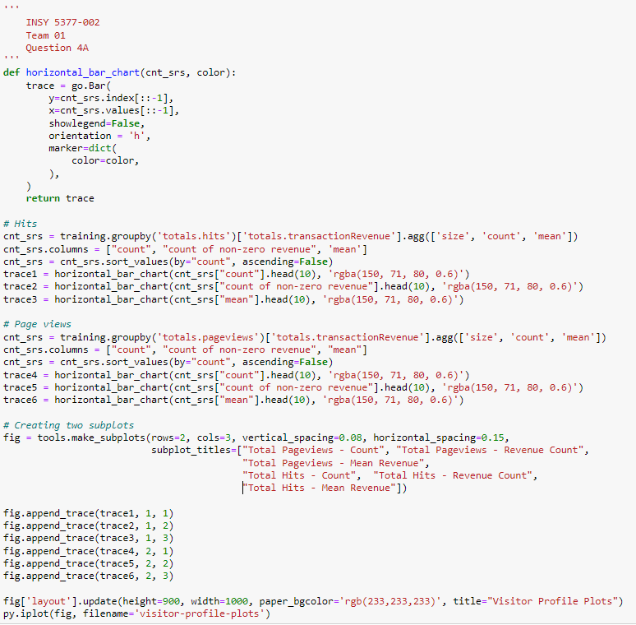
Results & Discussion: Question 4
What are the number of total hits & pageviews?
What is the conversion rate?

Slide 23
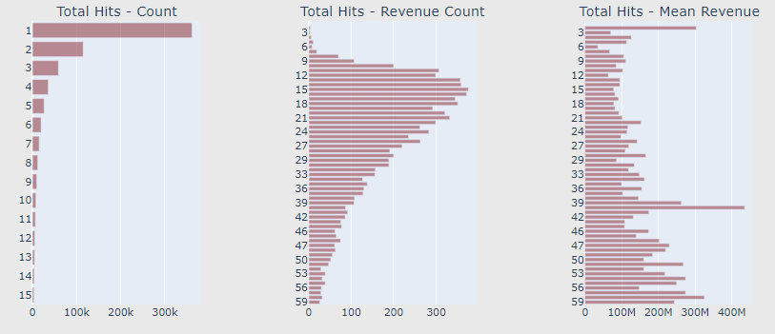
Results & Discussion: Question 4 (Cont.)
Total Visitors = 722,922k; Total Conversions = 9,178
362,239k, 50.1%
RETURN:
365,335k, 50.5%
362,239k, 50.1%
HITS >2:
360,683k, 49.9%

Slide 24
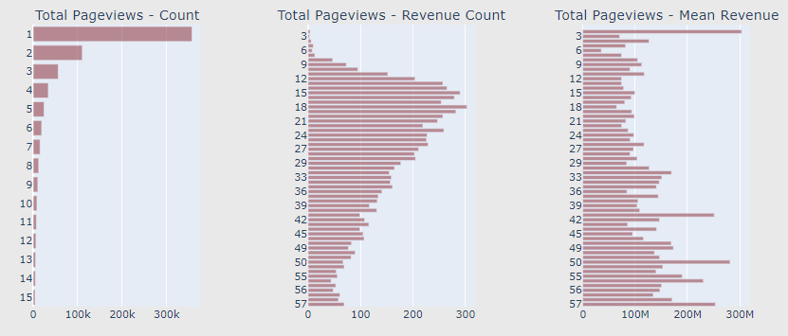
Results & Discussion: Question 4 (Cont.)
Total Visitors = 722,922k; Total Conversions = 9,178
357,587k, 49.5%
RETURN:
365,335k, 50.5%
362,239k, 50.1%
PAGEVIEWS >2:
365,335k, 50.5%

Slide 25
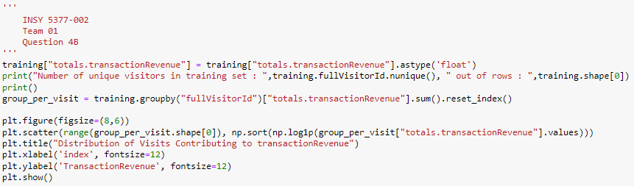
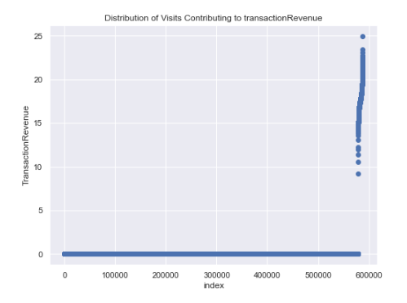
Results & Discussion: Question 4 (Cont.)
Total Visitors = 722,922k; Total Conversions = 9,178
362,239k, 50.1%
RETURN (>2):
360,683k, 49.9%
Only a small percentage of customers produce most of the revenue → marketing teams are challenged to make appropriate investments in promotional strategies.

Slide 26
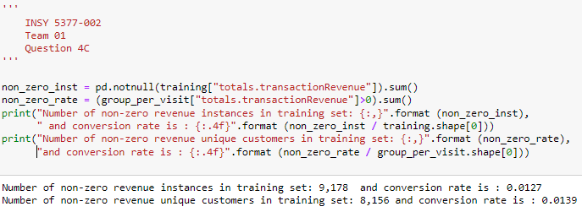
Results & Discussion: Question 4 (Cont.)
Total Visitors = 722,922k; Total Conversions = 9,178
362,239k, 50.1%
RETURN (>2):
360,683k, 49.9%

Slide 27
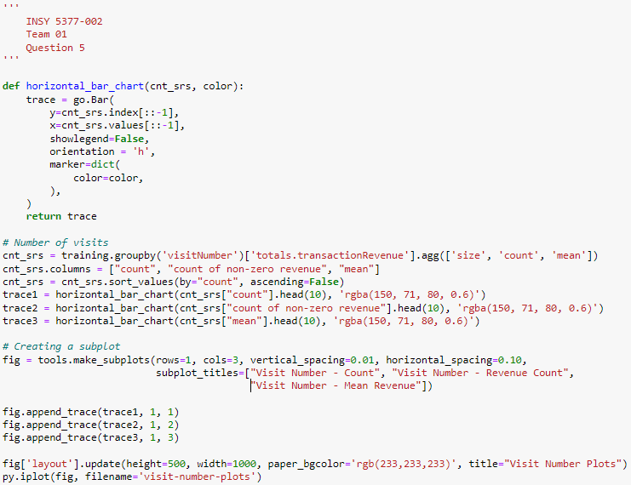
Results & Discussion: Question 5
What is the likelihood a visitor will see our website just once? What percentage of visitors return?
562,571k, 77.8%

Slide 28
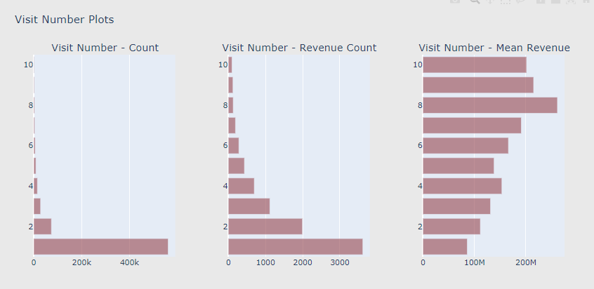
Results & Discussion: Question 5 (Cont.)
Total Visitors = 722,922k; Total Conversions = 9,178
RETURN (>1):
160,351k, 22.2%
562,571k, 77.8%
3620, 39.4%

Slide 29
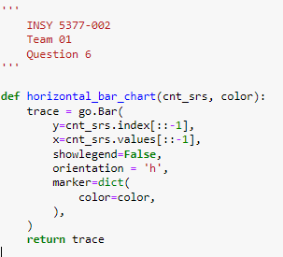
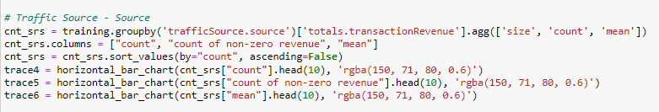
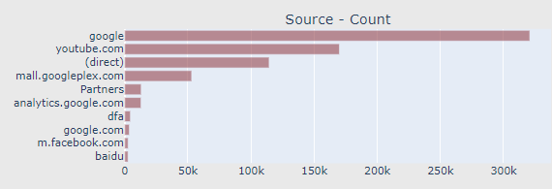
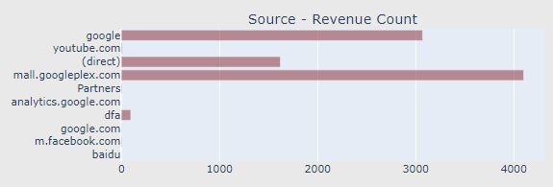
Results & Discussion: Question 6
Total Visitors = 722,922k; Total Conversions = 9,178
320,794k, 44.4%
3,071, 33.5%
114,409k, 15.8%
1,622, 17.7%
53,057k, 7.3%
4,102, 44.7%
Does one traffic source category dominate disproportionally?

Slide 30
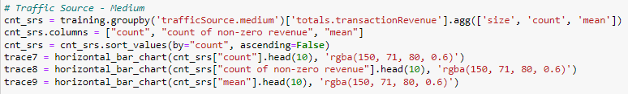


Results & Discussion: Question 7
Total Visitors = 722,922k; Total Conversions = 9,178
305,368k, 42.2%
2,722, 29.7%
264,633k, 36.6%
4,348, 47.4%
What is the trend for organic search traffic?

Slide 31




Results & Discussion: Question 8
What is the aggregated revenue generated from each user based on our independent variables?
Example Code - similar code was applied to obtain all of the results:

Slide 32





Results & Discussion: Question 8 (Cont.)

Slide 33





Results & Discussion: Question 8 (Cont.)

Slide 34
Results & Discussion: Question 9
Which features most contributed to the conversion of visitors?
Assuming circumstances in the future are similar, which features would most benefit GStore to focus on? How can GStore use this information to improve?
For our research, we built 3 predictive models in Python.
Our initial attempts with a Logistic Regression resulted in an overfitted model, due to the complex nature of the dataset.
Therefore, we ran a Random Forest Classifier predictive model to justify the previous model’s results.
Even after fine tuning with Grid Search and Stratified K-Fold Cross Validation, both our models have somewhat similar accuracies, hence confirming the logistics.
For further analysis on feature importance, the Light Gradient Boosting Machine (LGBM) was employed.
We used a Time Series to understand and analyze the patterns behind the online traffic volume.

Slide 35



Results & Discussion: Question 9 (Cont.)
Logistic Regression tends to overfit, and we realized we needed a different model better suited for larger and complex datasets.

Slide 36



Results & Discussion: Question 9 (Cont.)

Slide 37

Results & Discussion: Question 9 (Cont.)
Referral path is high from ongoing campaigns at the time.
As observed in Question 7 (Slide 30), visitors arrived through organic search.
This can be attributed to GStore’s direct and official affiliation with Google, who has already established a renowned presence on the Internet.
GStore’s site is already widely accessible on the web, but it can increase conversion with more campaigns.

Slide 38

Results & Discussion: Question 9 (Cont.)
We used a Light Gradient Boosting Machine (LGBM) to further analyze feature importance.
Especially applicable for analyzing large datasets.
In the name of “light”, it is not resource intensive. Very efficient.
Among the features, pageviews are high (i.e. possibly due to people hitting back on their browser, browsing multiple product pages).
As an online shopping site, having visitors exposed to more products is ideal.

Slide 39

Results & Discussion: Question 9 (Cont.)
Code for Time Series:

Slide 40

Results & Discussion: Question 9 (Cont.)
The following Time Series displays the daily number of visits from Q3 2016 through Q2 2017.
Multiple spikes in number of visits indicate:
Campaigns for GStore’s website (i.e. Black Friday, Holiday sales).
Google’s unveiling of their new line of smartphones, Pixel 1 was announced and released during October 2016.
We can observe visits typically lower outside of the last quarter of the year.
Could run campaigns throughout the year to increase overall build-up towards the end of the year.

Slide 41
Conclusion
From our research analyzing GStore’s online visitor metrics and behavior patterns, we have come up with suggestions that could improve their online business prospects.
GStore’s direct affiliation with Google is already attracting visitors. Utilizing this to the business’ advantage, continued targeting campaigns and improvements to the site can expand the site’s awareness and improve conversion prospects.
GStore should continue maintaining or improving customer retention.
Further investigation in creating campaigns targeted towards potential and prospective visitors in Asia and Europe can increase conversion rate.
Behavior patterns that reveal which visitors are more valuable to GStore.
For instance, GStore should prioritize optimizing their website for Safari, FireFox, and Google Chrome users.
Hosting additional campaigns throughout the year to extend the sales momentum beyond the Holiday season.
Google should look into site optimization for mobile users. The ubiquitous ability of mobile devices to access the web can increase GStore’s accessibility for all users, likely increasing retention and conversion rates.

Slide 42
References
Google Merchandise Store. [Logo of Google Merchandise Store] [Online image]. (n.d.). Retrieved July 14, 2022, from https://shop.googlemerchandisestore.com/
LightGBM. (n.d.). LightGBM. https://lightgbm.readthedocs.io/en/latest/Python-Intro.html
Masarat, S. (2018). Tutorial (Preprocessing, Processing, Evaluation). Kaggle. https://www.kaggle.com/code/smasar/tutorial-preprocessing-processing-evaluation
RStudio. (2018, November 23). Google Analytics Customer Revenue Prediction. Kaggle. https://www.kaggle.com/competitions/ga-customer-revenue-prediction/overview
SRK. (2018). Simple Exploration+Baseline - GA Customer Revenue. Kaggle. https://www.kaggle.com/code/sudalairajkumar/simple-exploration-baseline-ga-customer-revenue

